Slide 1


TVB-multiscale: interfacing TVB with NEST (and ANNarchy) spiking networks for multiscale co-simulation
D Perdikis, L. Domide, J. Mersmann, M. Schirner, P. Ritter Brain Simulation Section, Department of Neurology, Charité—Universitätsmedizin Berlin
Notes:
Good morning.
Today I will present to you TVB-multiscale, a new TVB package for interfacing TVB with spiking networks simulators, such as NEST, to perform mulsticale co-simulation.

Slide 2

Motivation
Populations’ level
Brain regions’ level
Populations’ activity as mean field system state variables
TVB: large-scale simulation linking brain anatomical data ((d)MRI, CT etc) to neuroimaging data, by generating virtual neural source activity.
Average activity of populations of spiking neurons
Spiking simulators (NEST, Neuron etc): fine-scale simulation for investigation of local or systems’ neural mechanisms
Neurons‘ level
Notes:
Now, the idea is to try to combine the two scales at the mesoscale of the level of populations of spiking neurons.
This is possible because state variables of the TVB mean field models usually correspond to the activity of neural populatiions,
and thus, can be linked with the average activity of spiking populations.

Slide 3
Software structure
TVB-multiscale/tvb_multiscale/core: extends TVB to perform multiscale co-simulation.
spiking_models: region_node, devices, network, and their builders
interfaces: tvb_to_spikeNet, spikeNet_to_tvb, and their builders
tvb/simulator_builder
data_analyzer/spiking_network_analyzer
plot, io (read/write to/from .h5 files), utils (utility scripts)
TVB-multiscale/tvb_multiscale/tvb_nest: Python interface of TVB with (Py)NEST, for co-simulation of TVB and NEST models.
nest_models: region_node, devices, network, their builders, builders of specific models
interfaces: tvb_to_nest, nest_to_tvb, their builders, builders of specific models
TVB-multiscale/tvb_multiscale/tvb_annarchy: Python interface of TVB with ANNarchy, for co-simulation of TVB and ANNarchy models.
annarchy_models: region_node, devices, network, their builders, builders of specific models
interfaces: tvb_to_annarchy, annarchy_to_tvb, their builders, builders of specific models
TVB-multiscale/tvb_multiscale/tvb_elephant:
spike_stimulus_builder
spiking_network_analyzer
TVB-multiscale/ docker, examples, tests, docs
https://github.com/the-virtual-brain/tvb-multiscale
https://hub.docker.com/r/thevirtualbrain/tvb-nest3
Notes:
We have implemented tvb-multiscale as a toolbox interfacing between TVB and the PyNEST to perform co-simulation.
PyNEST is a python interface to one of the post popular and mostly used spiking networks simulators, that is NEST.
You can find the code in the TVB github repository, as well as a docker image.

Slide 4
Default workflow
Setup configuration (min_delay, integration time resolution etc)
Build TVB model and simulator (connectivity, model, coupling, integrator, monitors etc)
Build Spiking Network model (neural populations, stimulation and measuring devices)
Build interfaces
(Co-)Simulate
Gather results, analyze, plot, write to .h5 files

Slide 5
EBRAINS collaboratory
https://tvb-nest.apps.hbp.eu/
https://wiki.ebrains.eu/bin/view/Collabs/the-virtual-brain-multiscale/
Notes:
So you can play yourself with all this in the HBP collab. Future work will be directed to validating these coupling schemes and eventually starting to use the toolbox in a real problem.

Slide 6
TVB-multiscale on EBRAINS collaboratory
Use case in EBRAINS Collaboratory:
1 excitatory (E) and 1 inhibitory (I) population per region node
Coarse-scale MF nodes in TVB with a reduced Wong-Wang model
fine-scale spiking networks SP nodes with an ”integrate-and-fire”, (alpha) conductance model (“iaf_cond_alpha”).
Notes:
We have implemented a Jupyter notebook illustrating a proof of concept use case that runs in the HBP collaboratory.
For this use case we have placed 1 excitatory and 1 inhibitory population at each brain region node.
The coarse scale MF nodes in TVB are modelled with a Reduced Wong Wang model,
And the 2 fine scale spiking nodes with an integrate – and – fire neuron mode that resembles a lot the original Wong Wang spiking neuron.
So, I am going to go through this use case in the next few slides in order to show you how we can couple the two models and simulators.

Slide 7
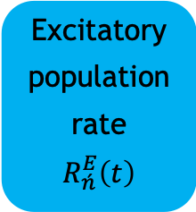
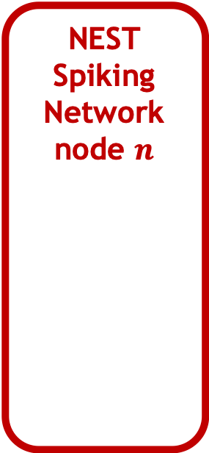
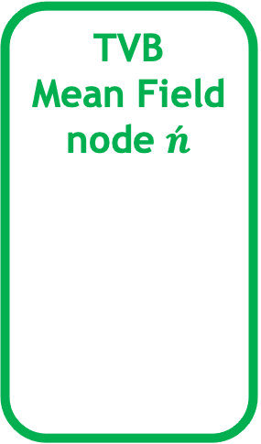
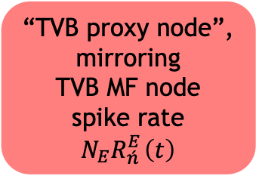
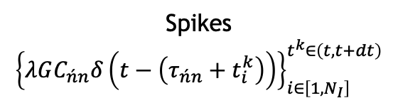
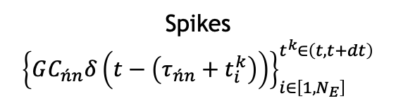
TVB to NEST coupling via TVB “proxy” nodes: spike rate
Use case
NEST
Spiking Network node $n$
TVB
Mean Field node $\acute{n}$
NEST device
generating spikes
Spikes
$${\left\{GC_{\acute{n}n}δ\left(t−\left(τ_{\acute{n}n}+t_{i}^{k}\right)\right)\right\}}_{i∈\left[1,N_{E}\right]}^{t^{k}∈\left(t,t+dt\right)}$$
Excitatory
population
E (g_{exc})
Excitatory
population
rate
$$R_{\acute{n}}^{E}\left(t\right)$$
“TVB proxy node”,
mirroring
TVB MF node
spike rate
$$N_{E}R_{\acute{n} }^{E}\left(t\right)$$
Inhibitory
population
I (g_{inh})
Spikes
$${\left\{λGC_{\acute{n}n}δ\left(t−\left(τ_{\acute{n}n}+t_{i}^{k}\right)\right)\right\}}_{i∈\left[1,N_{I}\right]}^{t^{k}∈\left(t,t+dt\right)}$$
Notes:
So, the main solution to this problem consists of building a representation of TVB inside the NEST network in the form of stimulating devices that mirror TVB nodes’ activity.
For instance in this case, the instantaneous rate state variable of the meanf field model updates at each time step of the simulation a spike generator device inside NEST,
and this device connects and sends spikes to all spiking neurons at each brain node modelled in NEST with a time delay and weight derived from the TVB connectome.
So, we need one such device for each TVB node that connects to the NEST nodes.

Slide 8
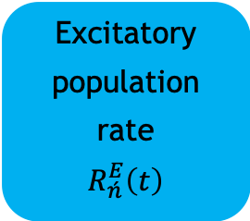
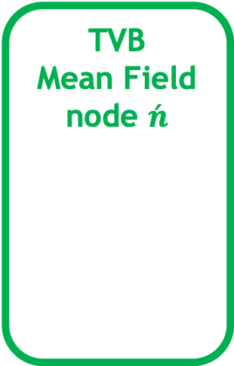
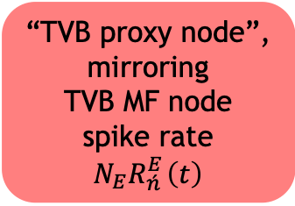
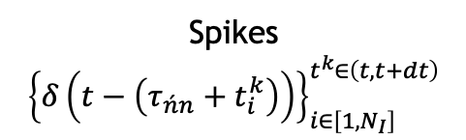
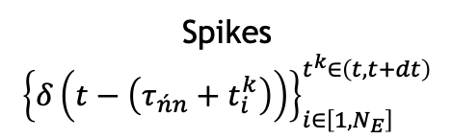
TVB to NEST coupling via TVB “proxy” nodes: spike rate
Use case
NEST
Spiking Network node $n$
TVB
Mean Field node $\acute{n}$
NEST device
generating spikes
Spikes
$${\left\{δ\left(t−\left(τ_{\acute{n}n}+t_{i}^{k}\right)\right)\right\}}_{i∈\left[1,N_{E}\right]}^{t^{k}∈\left(t,t+dt\right)}$$
Excitatory
population
E
Excitatory
population
rate
$$R_{\acute{n}}^{E}\left(t\right)$$
“TVB proxy node”,
mirroring
TVB MF node
spike rate
$$N_{E}R_{\acute{n} }^{E}\left(t\right)$$
Inhibitory
population
I
Spikes
$${\left\{δ\left(t−\left(τ_{\acute{n}n}+t_{i}^{k}\right)\right)\right\}}_{i∈\left[1,N_{I}\right]}^{t^{k}∈\left(t,t+dt\right)}$$
Notes:
So, the main solution to this problem consists of building a representation of TVB inside the NEST network in the form of stimulating devices that mirror TVB nodes’ activity.
For instance in this case, the instantaneous rate state variable of the meanf field model updates at each time step of the simulation a spike generator device inside NEST,
and this device connects and sends spikes to all spiking neurons at each brain node modelled in NEST with a time delay and weight derived from the TVB connectome.
So, we need one such device for each TVB node that connects to the NEST nodes.

Slide 9
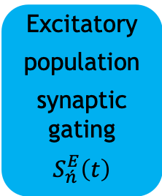
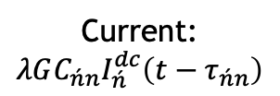
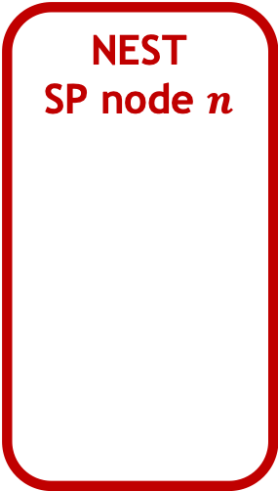
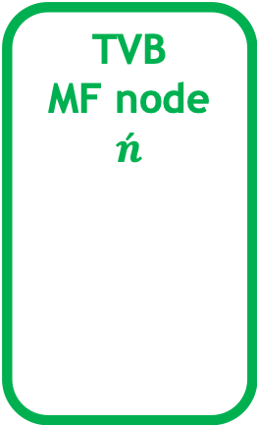
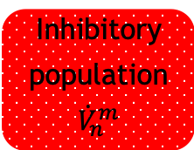
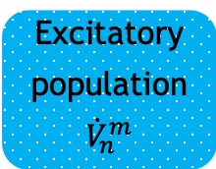
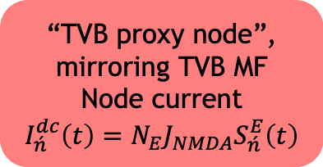
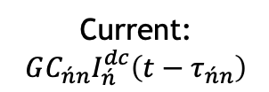
TVB to NEST coupling via TVB “proxy” nodes: current
Use case
NEST
SP node $n$
TVB
MF node $\acute{n}$
NEST device
generating dc current
Current:
$$GC_{\acute{n}n}I_{\acute{n}}^{dc}\left(t−τ_{\acute{n}n}\right)$$
Excitatory
population
$${\dot{V}}_{n}^{m}$$
Excitatory
population
synaptic gating
$$S_{\acute{n}}^{E}\left(t\right)$$
“TVB proxy node”,
mirroring TVB MF
Node current
$$I_{\acute{n}}^{dc}\left(t\right)=N_{E}J_{NMDA}S_{\acute{n}}^{E}\left(t\right)$$
Inhibitory
population
$${\dot{V}}_{n}^{m}$$
Current:
$$λGC_{\acute{n}n}I_{\acute{n}}^{dc}\left(t−τ_{\acute{n}n}\right)$$
Notes:
The model in the use case allows us to do this also with currents.
The synaptic gating state variable of the model multiplied by a constant becomes a current that can also be injected to all NEST nodes with weight and time delay determined by the TVB connectome.

Slide 10
TVB to NEST coupling via TVB “proxy” nodes: current
Use case
NEST
SP node $n$
TVB
MF node $\acute{n}$
NEST device
generating dc current
Current:
$$GC_{\acute{n}n}I_{\acute{n}}^{dc}\left(t−τ_{\acute{n}n}\right)$$
Excitatory
population
$${\dot{V}}_{n}^{m}$$
Excitatory
population
synaptic gating
$$S_{\acute{n}}^{E}\left(t\right)$$
“TVB proxy node”,
mirroring TVB MF
Node current
$$I_{\acute{n}}^{dc}\left(t\right)=N_{E}J_{NMDA}S_{\acute{n}}^{E}\left(t\right)$$
Inhibitory
population
$${\dot{V}}_{n}^{m}$$
Current:
$$λGC_{\acute{n}n}I_{\acute{n}}^{dc}\left(t−τ_{\acute{n}n}\right)$$
Notes:
The model in the use case allows us to do this also with currents.
The synaptic gating state variable of the model multiplied by a constant becomes a current that can also be injected to all NEST nodes with weight and time delay determined by the TVB connectome.

Slide 11
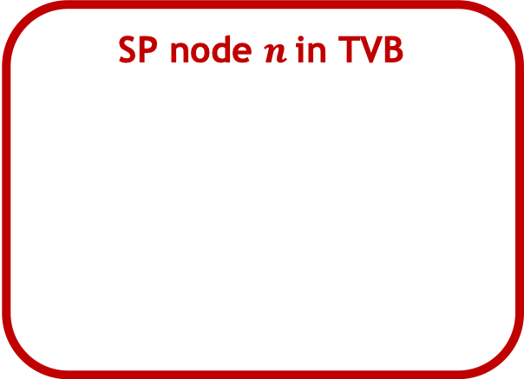
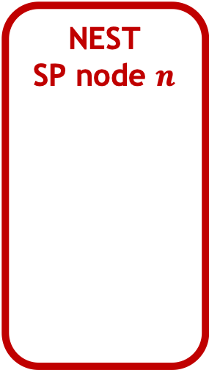
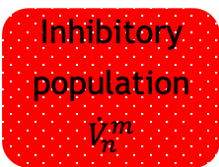
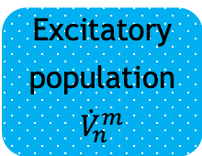
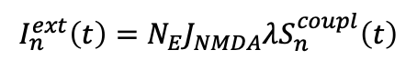
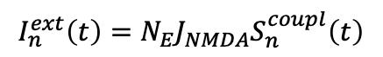
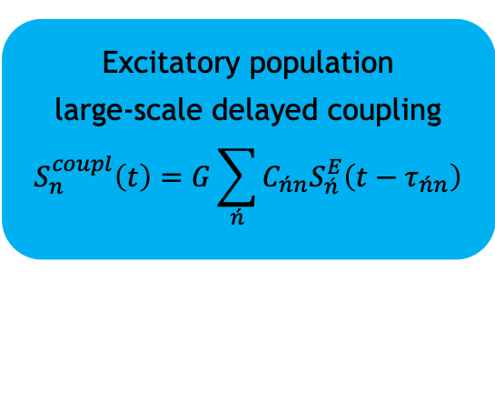
TVB to NEST coupling via direct parameter update
Use case
NEST
SP node $n$
SP node $n$ in TVB
NEST
external current parameter
Excitatory
population
$${\dot{V}}_{n}^{m}$$
Excitatory population
large-scale delayed coupling
$$S_{n}^{coupl}\left(t\right)=G\sum_{\acute{n}}{C_{\acute{n}n}S_{\acute{n}}^{E}\left(t−τ_{\acute{n}n}\right)}$$
$$I_{n}^{ext}\left(t\right)=N_{E}J_{NMDA}S_{n}^{coupl}\left(t\right)$$
Inhibitory
population
$${\dot{V}}_{n}^{m}$$
$$I_{n}^{ext}\left(t\right)=N_{E}J_{NMDA}λS_{n}^{coupl}\left(t\right)$$
Notes:
An alternative solution in the case of current is to take advantage of the fact that TVB anyway computes the large scale coupling for each node, with the proper weights and time delays,
And therefore we can directly apply this coupling input by modifying a parameter of external current on each neuron of the target spiking populations.
In this case connectivity is handled completely by TVB.

Slide 12


TVB to NEST coupling via direct parameter update
Use case
NEST
SP node $n$
SP node $n$ in TVB
NEST
external current parameter
Excitatory
population
$${\dot{V}}_{n}^{m}$$
Excitatory population
large-scale delayed coupling
$$S_{n}^{coupl}\left(t\right)=G\sum_{\acute{n}}{C_{\acute{n}n}S_{\acute{n}}^{E}\left(t−τ_{\acute{n}n}\right)}$$
$$I_{n}^{ext}\left(t\right)=N_{E}J_{NMDA}S_{n}^{coupl}\left(t\right)$$
Inhibitory
population
$${\dot{V}}_{n}^{m}$$
$$I_{n}^{ext}\left(t\right)=N_{E}J_{NMDA}λS_{n}^{coupl}\left(t\right)$$
Notes:
An alternative solution in the case of current is to take advantage of the fact that TVB anyway computes the large scale coupling for each node, with the proper weights and time delays,
And therefore we can directly apply this coupling input by modifying a parameter of external current on each neuron of the target spiking populations.
In this case connectivity is handled completely by TVB.

Slide 13
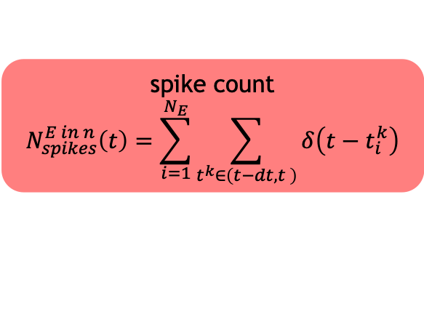
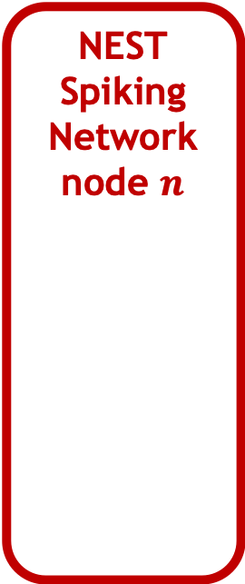
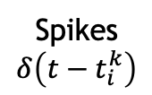
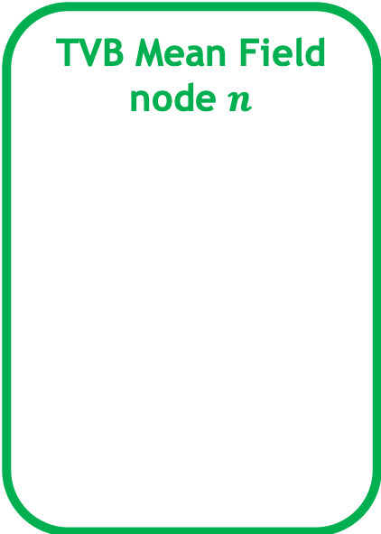
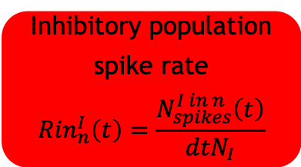
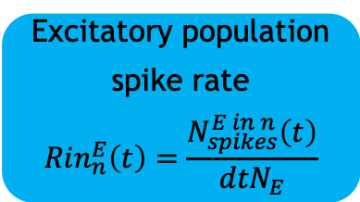

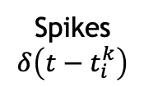
NEST to TVB update
Use case
NEST
Spiking Network node $n$
TVB Mean Field node $n$
NEST spike detector devices
Excitatory population
spike rate
$${Rin}_{n}^{E}\left(t\right)=\frac{N_{spikes}^{E in n}\left(t\right)}{{dtN}_{E}}$$
Spikes
$$δ\left(t−t_{i}^{k}\right)$$
spike count
$$N_{spikes}^{E in n}\left(t\right)=\sum_{i=1}^{N_{E}}{\sum_{t^{k}∈\left(t−dt,t \right)}{δ\left(t−t_{i}^{k}\right)}}$$
Excitatory
Population E
Inhibitory population
spike rate
$${Rin}_{n}^{I}\left(t\right)=\frac{N_{spikes}^{I in n}\left(t\right)}{{dtN}_{I}}$$
Spikes
$$δ\left(t−t_{i}^{k}\right)$$
spike count
$$N_{spikes}^{I in n}\left(t\right)=\sum_{i=1}^{N_{I}}{\sum_{t^{k}∈\left(t−dt,t \right)}{δ\left(t−t_{i}^{k}\right)}}$$
Inhibitory
Population
I
Notes:
Rinally, when we want to implement the update in nthe other direction as well, as is the case when we substitute a mean field node with a spiking network,
We use spike detector devices in NEST to detect spikes, count them and compute instantaneous rates to update the mean field nodes by overwriting the respective state variables of the model.
Thus, in this case of substitution we keep representing the whole brain in TVB and we can use all of its functionality like generating neuroimaging data for the whole brain etc.

Slide 14
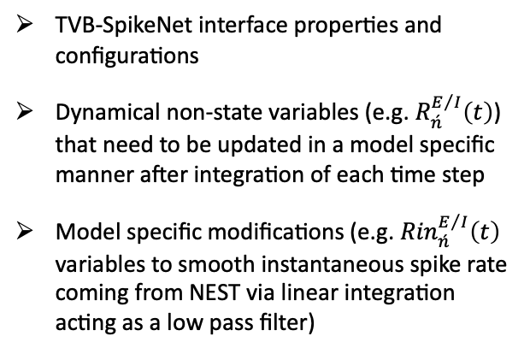
Modifications to the TVB simulator
TVB-SpikeNet interface properties and configurations
Dynamical non-state variables (e.g. $R_{\acute{n}}^{E/I}\left(t\right)$) that need to be updated in a model specific manner after integration of each time step
Model specific modifications (e.g. ${Rin}_{\acute{n}}^{E/I}\left(t\right)$ variables to smooth instantaneous spike rate coming from NEST via linear integration acting as a low pass filter)
Integration loop
TVB to SpikeNet coupling
TVB integration
SpikeNet integration
(Optional) SpikeNet to TVB update
Compute TVB large-scale coupling and update stimulus, if any
Update non-state dynamical variables (if any)
Update TVB history buffer
Generate TVB monitor outputs

Slide 15
References
Ritter P, Schirner M, McIntosh AR, Jirsa VK. 2013. The Virtual Brain integrates computational modeling and multimodal neuroimaging. Brain Connectivity 3:121–145. ﻿
Sanz Leon P, Knock SA, Woodman MM, Domide L, Mersmann J, McIntosh AR, Jirsa V. 2013. The Virtual Brain: a simulator of primate brain network dynamics. Frontiers in Neuroinformatics 7:10.
Jordan, Jakob, Mørk, Håkon, Vennemo, Stine Brekke, Terhorst, Dennis, Peyser, Alexander, Ippen, Tammo, … Plesser, Hans Ekkehard. (2019, June 27). NEST 2.18.0 (Version 2.18.0). Zenodo.
Deco G, Ponce-Alvarez A, Mantini D, Romani GL, Hagmann P, Corbetta M. 2013. Resting-State Functional Connectivity Emerges from Structurally and Dynamically Shaped Slow Linear Fluctuations. The Journal of Neuroscience 33(27): 11239 –11252.
Perdikis D, Schirner M, Diaz-Cortes, M-A, Domide L, Mersmann J, Ritter P (in prep).

Slide 16
Notes:
Thank you very much!

Slide 17
Motivation
Brain regions’ level
TVB: large-scale simulation linking brain anatomical data ((d)MRI, CT etc) to neuroimaging data, by generating virtual neural source activity.
Notes:
First, I would like to talk about the motivation behind this project.
As you probaly already know TVB is pretty unique in linking brain anatomical data such as (diffusion) MRI, CT scans etc, to neuroimaging data,
by generative model simulation, i.e., by generating virtual neural source activity and the repective virtual nueroimaging data.

Slide 18
Motivation
Brain regions’ level
TVB: large-scale simulation linking brain anatomical data ((d)MRI, CT etc) to neuroimaging data, by generating virtual neural source activity.
Spiking simulators (NEST, Neuron etc): fine-scale simulation for investigation of local or systems’ neural mechanisms
Neurons‘ level
Notes:
However there are cases where this large scale of description of the brain is not adequate because we want to investigate neural mechanisms at a local or systems’ level.
This can be done by simulating spiking neuron networks with simulator such as NEST and Neuron

Slide 19
Motivation
Populations’ level
Brain regions’ level
Populations’ activity as mean field system state variables
TVB-multiscale interfaces for multiscale co-simulation:
TVB Spiking simulators: Generate biologically realistic spatio-temporal context and large-scale connectivity for local neural networks
TVB Spiking simulators: Confirm mean field approximations on large-scale brain statistics (e.g., functional connectivity)
Average activity of populations of spiking neurons
Neurons‘ level
Notes:
We can envision case where something like this would be possible, as for instance when we want to generate a spatio-temporal context for spiking neurons that is biologically meaningfull,
That is inputs from the rest of the brain that will be richer in information than a simple random spike train or an oscillatory signal that is usually today the case.
In other situations, we might benefit from bidirectional coupling when for instance we want to validate the mean field approximations on large scale brain statistic such as functional connectivity or the network dynamics bifurcaitons, by substituting some mean field nodes with spiking networks.

Slide 20
NEST to TVB update
Use case
NEST
Spiking Network node $n$
TVB Mean Field node $n$
NEST spike detector devices
Excitatory population
spike rate
$${Rin}_{n}^{E}\left(t\right)=\frac{N_{spikes}^{E in n}\left(t\right)}{{dtN}_{E}}$$
Spikes
$$δ\left(t−t_{i}^{k}\right)$$
spike count
$$N_{spikes}^{E in n}\left(t\right)=\sum_{i=1}^{N_{E}}{\sum_{t^{k}∈\left(t−dt,t \right)}{δ\left(t−t_{i}^{k}\right)}}$$
Excitatory
Population E
Inhibitory population
spike rate
$${Rin}_{n}^{I}\left(t\right)=\frac{N_{spikes}^{I in n}\left(t\right)}{{dtN}_{I}}$$
Spikes
$$δ\left(t−t_{i}^{k}\right)$$
spike count
$$N_{spikes}^{I in n}\left(t\right)=\sum_{i=1}^{N_{I}}{\sum_{t^{k}∈\left(t−dt,t \right)}{δ\left(t−t_{i}^{k}\right)}}$$
Inhibitory
Population
I
Notes:
Rinally, when we want to implement the update in nthe other direction as well, as is the case when we substitute a mean field node with a spiking network,
We use spike detector devices in NEST to detect spikes, count them and compute instantaneous rates to update the mean field nodes by overwriting the respective state variables of the model.
Thus, in this case of substitution we keep representing the whole brain in TVB and we can use all of its functionality like generating neuroimaging data for the whole brain etc.

Slide 21
NEST network builder: define neural populations
Use case
Notes:
Rinally, when we want to implement the update in nthe other direction as well, as is the case when we substitute a mean field node with a spiking network,
We use spike detector devices in NEST to detect spikes, count them and compute instantaneous rates to update the mean field nodes by overwriting the respective state variables of the model.
Thus, in this case of substitution we keep representing the whole brain in TVB and we can use all of its functionality like generating neuroimaging data for the whole brain etc.

Slide 22
NEST network builder: define connections within regions
Use case
Notes:
Rinally, when we want to implement the update in nthe other direction as well, as is the case when we substitute a mean field node with a spiking network,
We use spike detector devices in NEST to detect spikes, count them and compute instantaneous rates to update the mean field nodes by overwriting the respective state variables of the model.
Thus, in this case of substitution we keep representing the whole brain in TVB and we can use all of its functionality like generating neuroimaging data for the whole brain etc.

Slide 23
NEST network builder: define connections among regions
Use case
Notes:
Rinally, when we want to implement the update in nthe other direction as well, as is the case when we substitute a mean field node with a spiking network,
We use spike detector devices in NEST to detect spikes, count them and compute instantaneous rates to update the mean field nodes by overwriting the respective state variables of the model.
Thus, in this case of substitution we keep representing the whole brain in TVB and we can use all of its functionality like generating neuroimaging data for the whole brain etc.

Slide 24
NEST network builder: stimulus input devices
Use case
Notes:
Rinally, when we want to implement the update in nthe other direction as well, as is the case when we substitute a mean field node with a spiking network,
We use spike detector devices in NEST to detect spikes, count them and compute instantaneous rates to update the mean field nodes by overwriting the respective state variables of the model.
Thus, in this case of substitution we keep representing the whole brain in TVB and we can use all of its functionality like generating neuroimaging data for the whole brain etc.

Slide 25
NEST network builder: output measuring devices
Use case
Notes:
Rinally, when we want to implement the update in nthe other direction as well, as is the case when we substitute a mean field node with a spiking network,
We use spike detector devices in NEST to detect spikes, count them and compute instantaneous rates to update the mean field nodes by overwriting the respective state variables of the model.
Thus, in this case of substitution we keep representing the whole brain in TVB and we can use all of its functionality like generating neuroimaging data for the whole brain etc.

Slide 26
Benchmarking
Notes:
Rinally, when we want to implement the update in nthe other direction as well, as is the case when we substitute a mean field node with a spiking network,
We use spike detector devices in NEST to detect spikes, count them and compute instantaneous rates to update the mean field nodes by overwriting the respective state variables of the model.
Thus, in this case of substitution we keep representing the whole brain in TVB and we can use all of its functionality like generating neuroimaging data for the whole brain etc.

